Slide 1

VIP 4.0
Team Member(s): Joseph Gonzalez, Nandini Dandu, Shefali Nakum, Ravi Kiran, Franco Hernandez Product Owner(s): Mohsen Taheri
Instructor: Masoud Sadjadi School of Computing and Information Sciences Florida International University
Final Presentation
Fall 2016
t
Notes:
7 seconds.
Greet your audience, thank them for attending your presentation, introduce yourself, introduce your project, introduce your team members, and quickly indicate what each of you did in a high-level manner, and put more emphasis on your part/contribution.

Slide 2
Project definition
Problems with VIP 3.0
Project Management Issues
Formatting Issues
Data Organization
No Archiving System
Report Generating
Etc...
Notes:
20 seconds.
Introduce the problem that the your project (in new version) tackles with GIF or screenshot.

Slide 3
Project definition
Notes:
10 seconds.
Introduce the problem that the whole project (in all versions) tackles with GIF or screenshot.

Slide 4
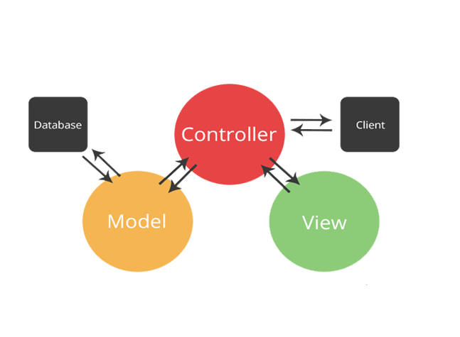

System Design: Architecture
Software:
MVC
Hardware:
Client-Server
Notes:
20 seconds
System design: Highlight the parts that you contributed to them.
1. System decomposition; identify the architecture patterns used
2. System deployment – h/w and s/w requirements

Slide 5
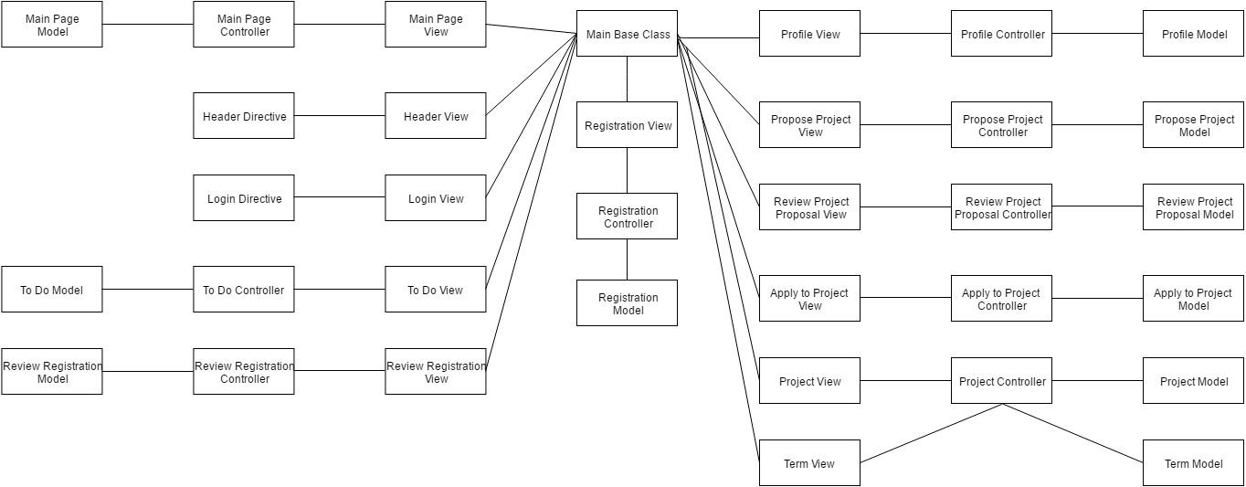
Minimal Class Diagram
Notes:
10 seconds.Minimal class diagram. Highlight the classes that you created/modified
Identify the design patterns used (one or more slides).

Slide 6
User Stories
Project Lock Features
Faculties registration page
Preserving the format of Project’s Description
Adding Excel report in Admin Panel.
Notes:
5 seconds.
List the user stories that you worked on them.(put in order of importance). Stay focused on the parts that you have been working.

Slide 7
Project Lock Features
Before: There was no system in place to manage projects long term over multiple semesters.
After: Projects can now be attached to a specific Semester, with both individual projects and entire semester’s being lockable.
Notes:
60 seconds
The tile of user story
The most important user story you worked on it. You have to describe this one very well and be proud of that.
Please present and show the complexity of your work, code, algorithms, and technical challenges and technologies you have used. (you could use screenshot if you want. Visual presentations are better than text presentation)
Go into the details of the most important/significant tasks using bullet lists or visual graphs or state chart diagram
Sequence Diagram for this user story is mandatory (in another separate page if required)
Demo using screenshots or GIF (in another separate page if required)

Slide 8
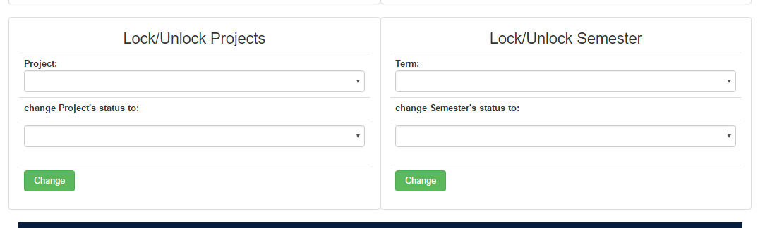
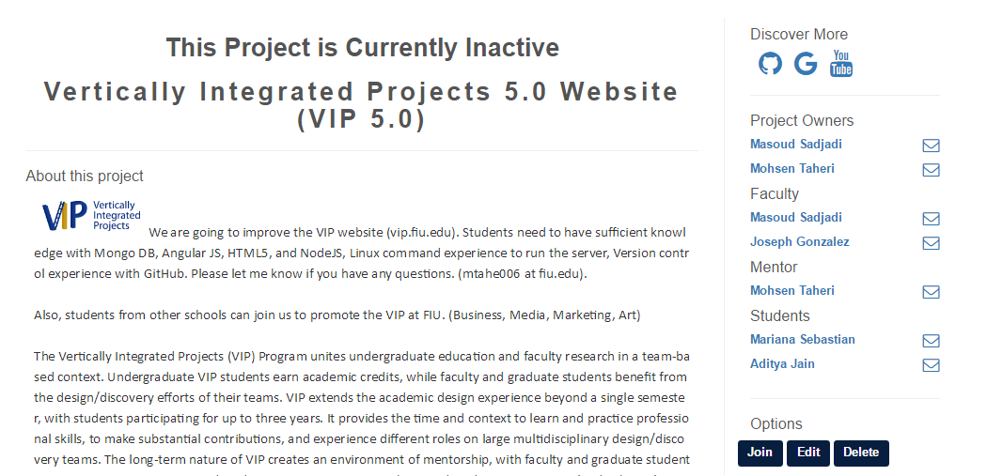
New Panels to Lock Projects and Semesters
Display Status Message on Project Pages

Slide 9
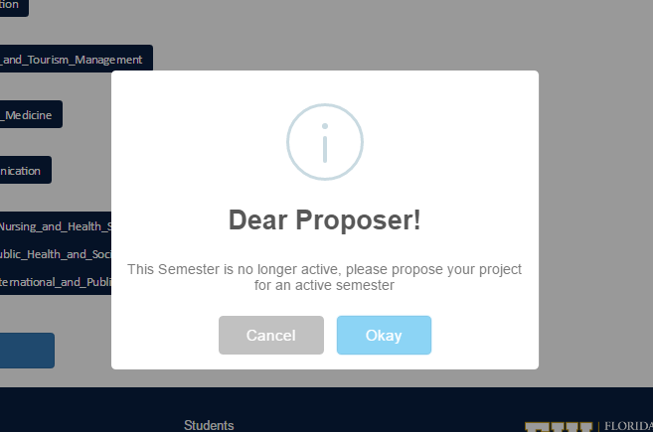
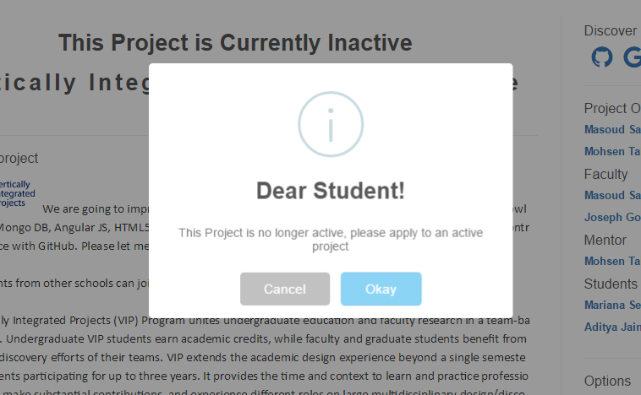
Professor Notifications
Student Notifications

Slide 10
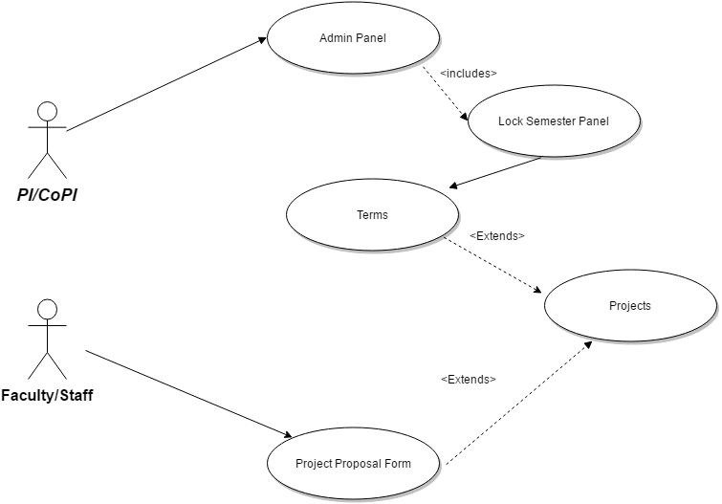
Use Case Diagram

Slide 11
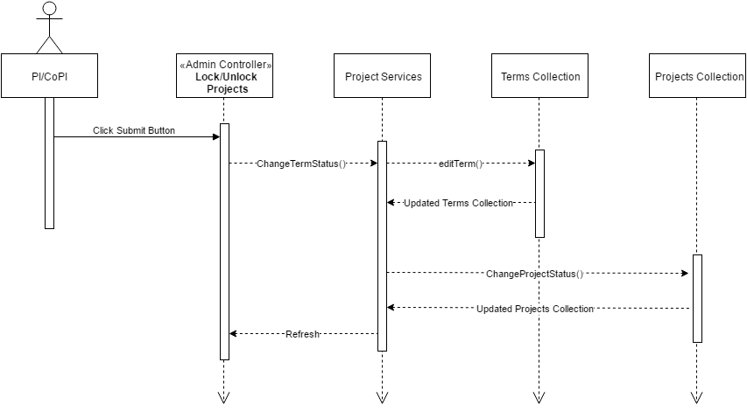
Sequence Diagram

Slide 12
Faculty Registration Page
Before: There was no way for the Pi/Copi to view the list of faculties registration requests.
After: Now the vip website contains a feature called “REVIEW FACULTY REGISTRATIONS”, where Pi/Copi can Approve, Reject, Undo or Delete the faculty registration request.

Slide 13
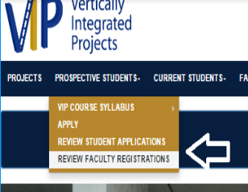
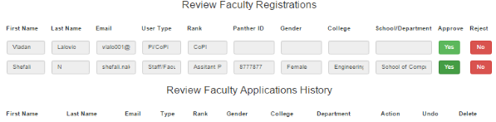
Link to view the list of faculties
registrations
List of the registered faculties with an additional feature called Approves/ Rejects/Undo/Delete
Notes:
20 seconds
The tile of user story
Please present and show the complexity of your work, code, algorithms, and technical challenges and technologies you have used. (you could use screenshot if you want. Visual presentations are better than text presentation) - Go into the details of the most important/significant tasks using bullet lists or visual graphs or state chart diagram - Demo using screenshots or GIF (in another separate page if required)
Sequence Diagram for this user story is optional

Slide 14
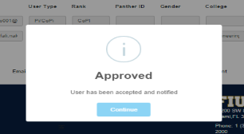
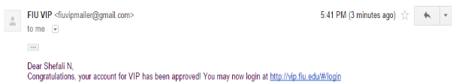
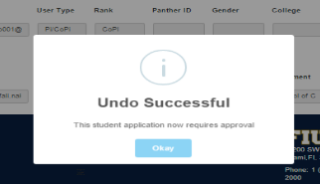
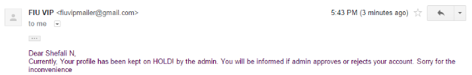
Faculty will be notified according to the action taken by Pi/CoPi
Case 1: If Pi/CoPi approves the request
Case 2: If Pi/CoPi Undo the request

Slide 15
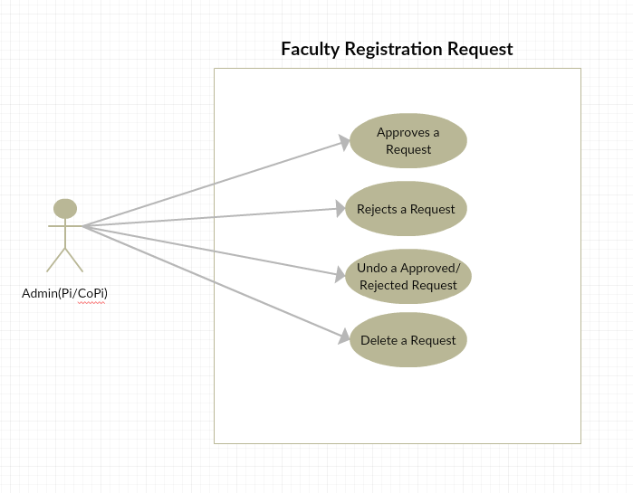
Use Case Diagram

Slide 16
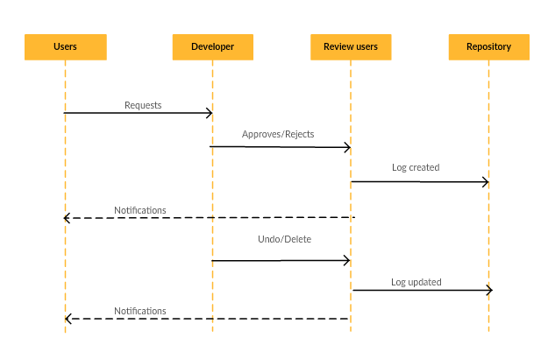
Sequence Diagram
Notes:
20 seconds
The tile of user story
Please present and show the complexity of your work, code, algorithms, and technical challenges and technologies you have used. (you could use screenshot if you want. Visual presentations are better than text presentation) - Go into the details of the most important/significant tasks using bullet lists or visual graphs or state chart diagram - Demo using screenshots or GIF (in another separate page if required)
Sequence Diagram for this user story is optional

Slide 17
Format to “Project Proposal Form’s team description
Before: There was no way to keep same format of the description entered by the Faculty.
After: Now the faculty can use the text editor and propose the description in a format which will be preserved throughout the website.
Notes:
20 seconds
The tile of user story
Please present and show the complexity of your work, code, algorithms, and technical challenges and technologies you have used. (you could use screenshot if you want. Visual presentations are better than text presentation) - Go into the details of the most important/significant tasks using bullet lists or visual graphs or state chart diagram - Demo using screenshots or GIF (in another separate page if required)
Sequence Diagram for this user story is optional

Slide 18
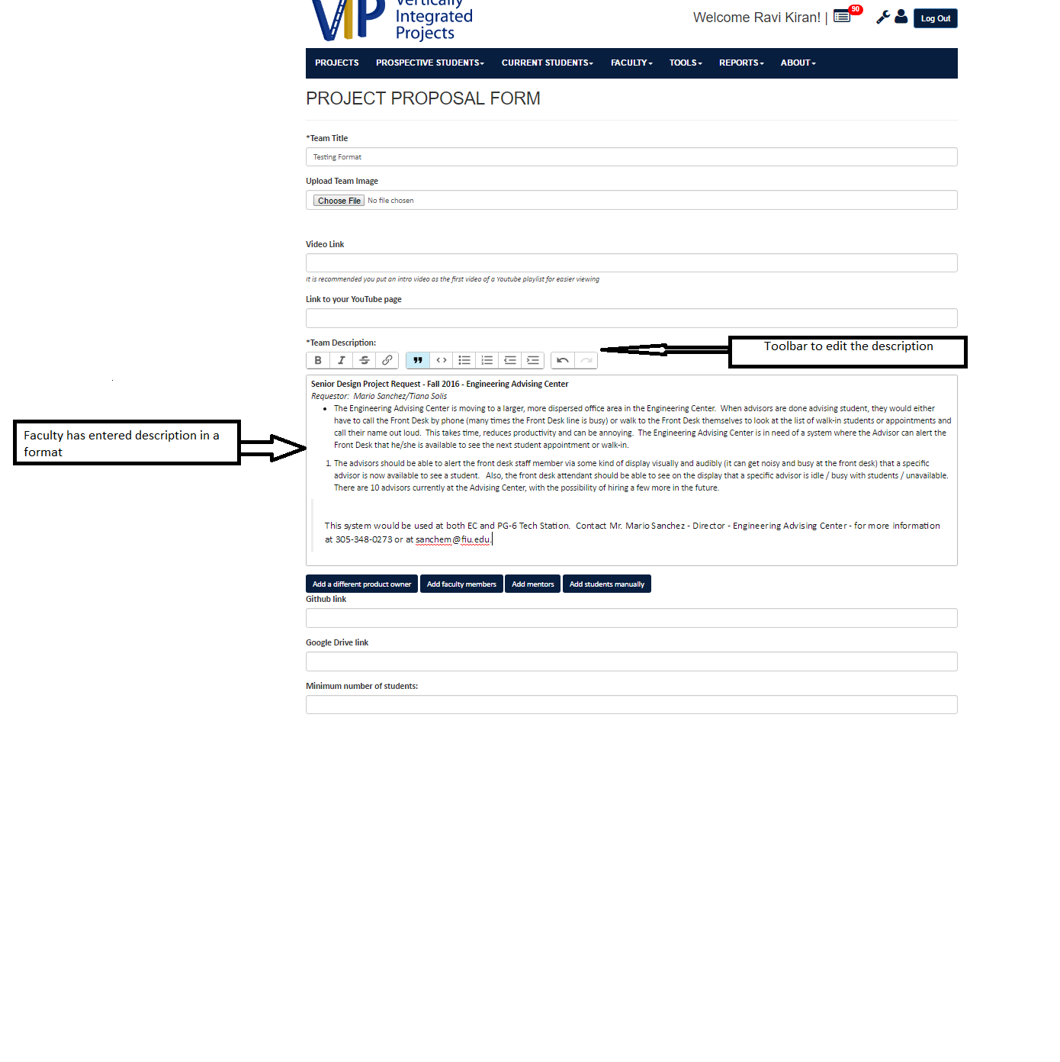
Text Editor for Project Description
Notes:
20 seconds
The tile of user story
Please present and show the complexity of your work, code, algorithms, and technical challenges and technologies you have used. (you could use screenshot if you want. Visual presentations are better than text presentation) - Go into the details of the most important/significant tasks using bullet lists or visual graphs or state chart diagram - Demo using screenshots or GIF (in another separate page if required)
Sequence Diagram for this user story is optional

Slide 19
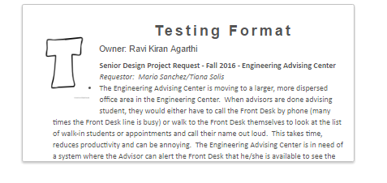
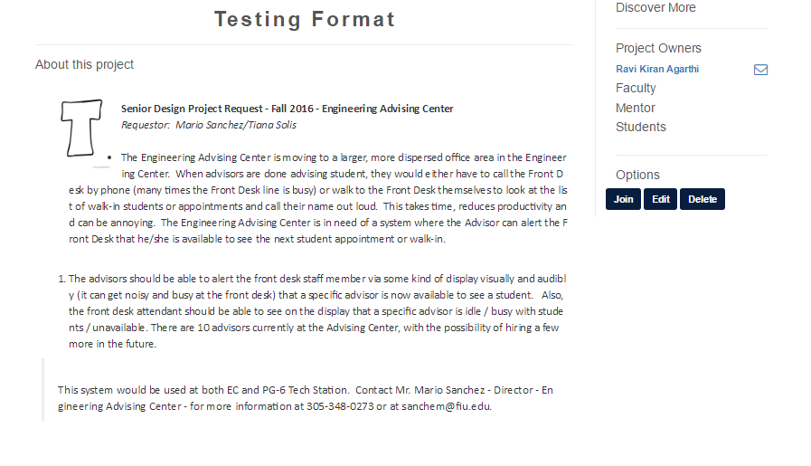
Projects Page
Project in Detail View

Slide 20
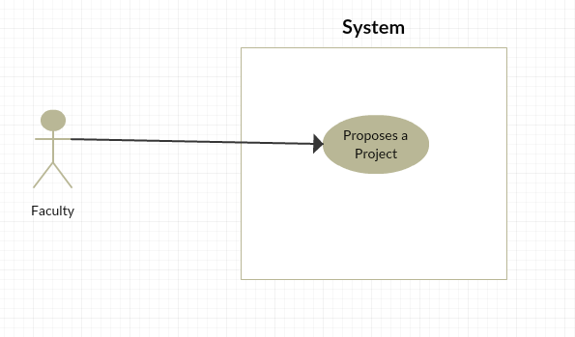
Use Case Diagram
Notes:
10 seconds
A description of verification process and Test Suites and Test Cases for one of the use cases.
1 One sunny day and one rainy day for the implemented use cases (one or more slides).
2 Automated test scripts for the implemented use cases (if any) (one or more slides).

Slide 21
Adding Excel report in Admin Panel.
Before: The admin had to manually select the students information and copy it to an excel file.
After: The admin can simply search the list of students that he want and generate an excel report along with the date.

Slide 22
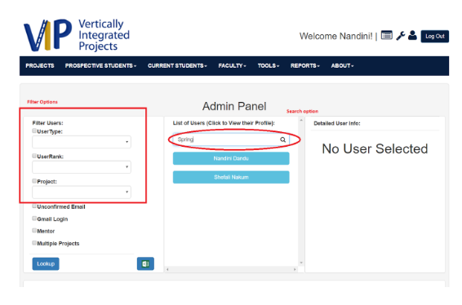
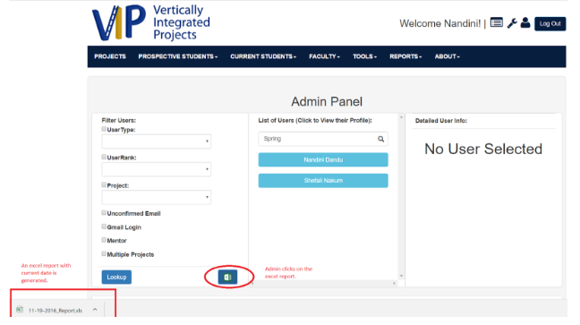
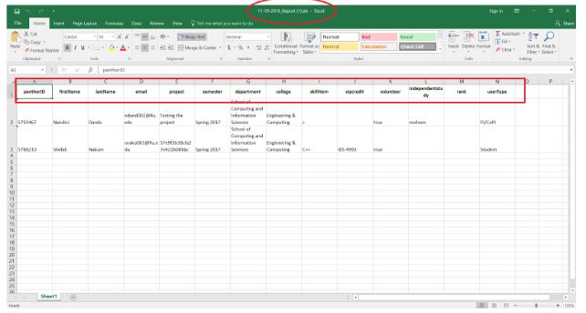
Admin searches for the students with the filters on the left or in the search box
He clicks on the Excel Icon, automatically the file is downloaded with the current date.
The Excel report with respective information

Slide 23
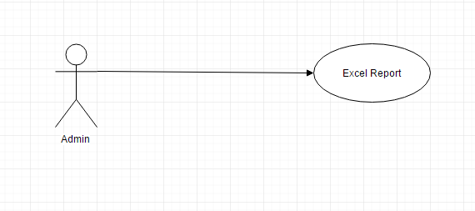
Use Case Diagram

Slide 24
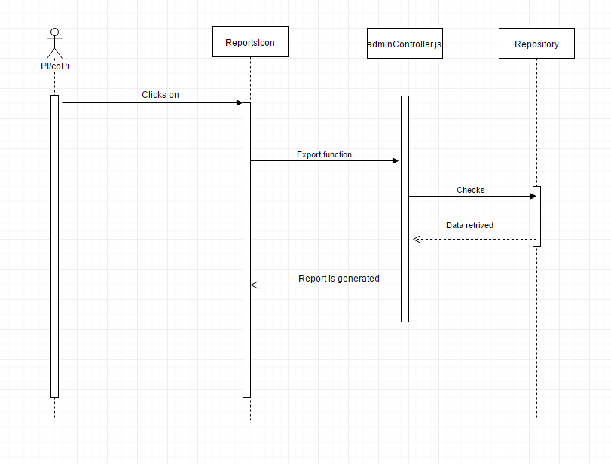
Sequence Diagram

Slide 25
SUMMARY
VIP 4.0 has a new page for admin to review faculties registration requests.
VIP 4.0 now has a text editor in project form,with which faculties can edit the description in the desired format.
VIP 4.0 now gives admin more feasibility to search for a specific user in admin panel.
VIP 4.0 gives admin the feature to quickly get the information of the students that he wants just by searching and clicking on the excel report to generate one.

Slide 26




Summary
We can be contacted via email at jgonz770@fiu.edu, snaku001@fiu.edu, ragar005@fiu.edu, ndand002@fiu.edu,fhern030@fiu.edu.
Questions?
Thank You!
Notes:
10 seconds
Summarize your contribution, mention your effort for Scrum, Mingle, Github, Google Drive Documentation and minutes
Include your contact information
Ask if anyone has any questions for you.
Thank your audience

